Slide 2
Java program layout
A typical Java file looks like:
import java.awt.*; import java.util.*;
public class SomethingOrOther { // object definitions go here . . . }
This must be in a file named SomethingOrOther.java !

Slide 3
Java Foundation Packages
Java provides a large number of classes groped into different packages based on their functionality
The six foundation Java packages are:
- java.lang :
Contains classes for primitive types, strings, math functions, threads, and exception.
- java.util :
Contains classes such as vectors, hash tables, date etc.
- java.io :
Stream classes for I/O .
- java.net :
Classes for networking .
- java.applet :
Classes for creating and implementing app.

Slide 4
Packages
Packages are Java’s way of grouping a number of related classes and/or interfaces together into a single unit. That means, packages act as “containers” for classes.
The benefits of organising classes into packages are:
- The classes contained in the packages of other programs/applications can be reused.
- In packages classes can be unique compared with classes in other packages. That two classes in two different packages can have the same name. If there is a naming clash, then classes can be accessed with their fully qualified name.
- Classes in packages can be hidden if we don’t want other packages to access them.
- Packages also provide a way for separating “design” from coding.

Slide 5
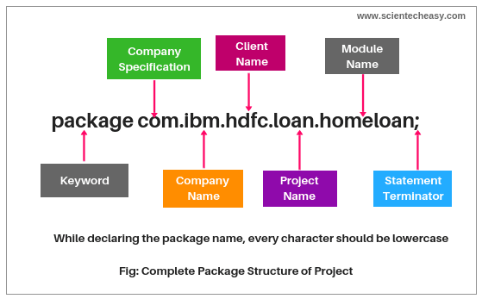

Slide 6
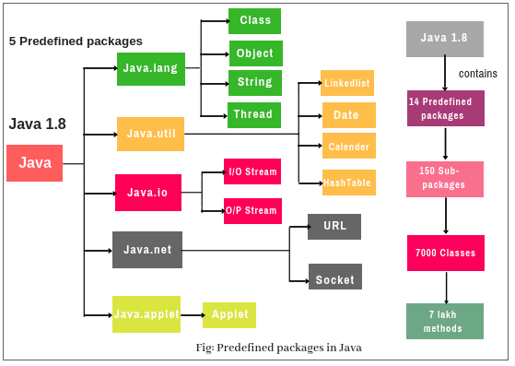

Slide 7
Accessing Classes from Packages
There are two ways of accessing the classes stored in packages:
Using fully qualified class name
java.lang.Math.sqrt(x);
Import package and use class name directly
import java.lang.Math
Math.sqrt(x);
Selected or all classes in packages can be imported:
Implicit in all programs: import java.lang.*;
package statement(s) must appear first
import package.class;
import package.*;

Slide 8
Creating Packages
Java supports a keyword called “package” for creating user-defined packages. The package statement must be the first statement in a Java source file (except comments and white spaces) followed by one or more classes.
package myPackage;
public class ClassA {
// class body
}
class ClassB {
}
Package name is “myPackage” and classes are considered as part of this package; The code is saved in a file called “ClassA.java” and located in a directory called “myPackage”.

Slide 9
Accessing a Package
As indicated earlier, classes in packages can be accessed using a fully qualified name or using a short-cut as long as we import a corresponding package.
The general form of importing package is:
import package1[.package2][…].classname
Example:
import myPackage.ClassA;
import myPackage.secondPackage ;
All classes/packages from higher-level package can be imported as follows:
import myPackage.*;

Slide 10
Using a Package
Let us store the code listing below in a file named“ClassA.java” within subdirectory named “myPackage”within the current directory (say “abc”).
package myPackage;
public class ClassA {
// class body
public void display()
{
System.out.println("Hello, I am ClassA");
}
}
class ClassB {
// class body
}

Slide 11
Using a Package
Within the current directory (“abc”) store the following code in a file named“ClassX.java”
import myPackage.ClassA;
public class ClassX
{
public static void main(String args[])
{
ClassA objA = new ClassA();
objA.display();
}
}

Slide 12
Using a Package
Let us store the code listing below in a file named“ClassA.java” within subdirectory named“secondPackage” within the current directory (say“abc”).
public class ClassC {
// class body
public void display()
{
System.out.println("Hello, I am ClassC");
} }

Slide 13
Using a Package
Within the current directory (“abc”) store the following code in a file named“ClassX.java”
import myPackage.ClassA;
import secondPackage.ClassC;
public class ClassY
{
public static void main(String args[])
{
ClassA objA = new ClassA();
ClassC objC = new ClassC();
objA.display();
objC.display();
}
}

Slide 14
Output
Hello, I am ClassA
Hello, I am ClassC

Slide 15
Scanner Class in Java
Scanner is a class in java.util package used for obtaining the input of the primitive types like int, double, etc. and strings. It is the easiest way to read input in a Java program.
To create an object of Scanner class, we usually pass the predefined object System.in, which represents the standard input stream. We may pass an object of class File if we want to read input from a file.
To read numerical values of a certain data type XYZ, the function to use is nextXYZ(). For example, to read a value of type short, we can use nextShort()
To read strings, we use nextLine().
To read a single character, we use next().charAt(0). next() function returns the next token/word in the input as a string and charAt(0) function returns the first character in that string.
The Scanner class reads an entire line and divides the line into tokens. Tokens are small elements that have some meaning to the Java compiler. For example, Suppose there is an input string: How are you
In this case, the scanner object will read the entire line and divides the string into tokens: “How”, “are” and “you”. The object then iterates over each token and reads each token using its different methods.

Slide 16
// Java program to read data of various types using Scanner class.
import java.util.Scanner;
public class ScannerDemo1
{
public static void main(String[] args)
{
// Declare the object and initialize with
// predefined standard input object
Scanner sc = new Scanner(System.in);
// String input
String name = sc.nextLine();
// Character input
char gender = sc.next().charAt(0);
// Numerical data input
// byte, short and float can be read
// using similar-named functions.
int age = sc.nextInt();
long mobileNo = sc.nextLong();
double cgpa = sc.nextDouble();
// Print the values to check if the input was correctly obtained.
System.out.println("Name: "+name);
System.out.println("Gender: "+gender);
System.out.println("Age: "+age);
System.out.println("Mobile Number: "+mobileNo);
System.out.println("CGPA: "+cgpa);
}
}

Slide 17
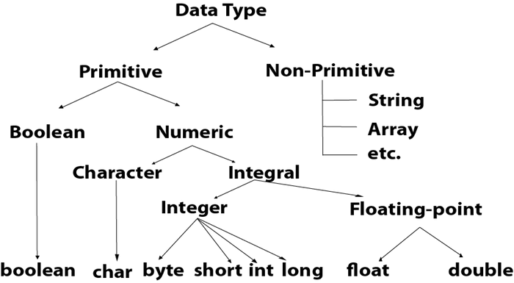
Data Types

Slide 18
Data Type | Default Value | Default size
boolean | false | 1 bit
char | '\u0000' | 2 byte
byte | 0 | 1 byte
short | 0 | 2 byte
int | 0 | 4 byte
long | 0L | 8 byte
float | 0.0f | 4 byte
double | 0.0d | 8 byte

Slide 19
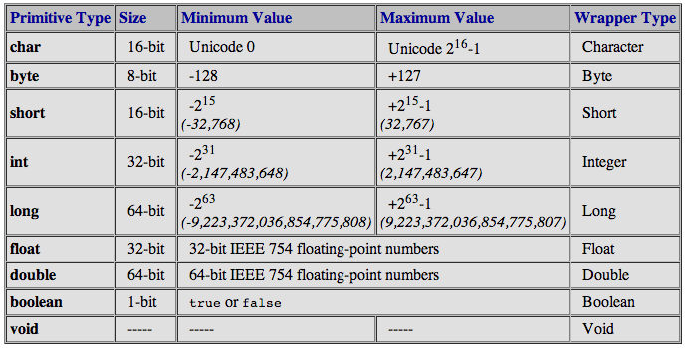

Slide 20
Byte Data Type
The byte data type is an example of primitive data type. It is an 8-bit signed two's complement integer. Its value-range lies between -128 to 127 (inclusive). Its minimum value is -128 and maximum value is 127. Its default value is 0.
The byte data type is used to save memory in large arrays where the memory savings is most required. It saves space because a byte is 4 times smaller than an integer. It can also be used in place of "int" data type.

Slide 21
Short Data Type
The short data type is a 16-bit signed two's complement integer. Its value-range lies between -32,768 to 32,767 (inclusive). Its minimum value is -32,768 and maximum value is 32,767. Its default value is 0.
The short data type can also be used to save memory just like byte data type. A short data type is 2 times smaller than an integer.

Slide 22
Int Data Type
The int data type is a 32-bit signed two's complement integer. Its value-range lies between - 2,147,483,648 (-2^31) to 2,147,483,647 (2^31 -1) (inclusive). Its minimum value is - 2,147,483,648 and maximum value is 2,147,483,647. Its default value is 0.
The int data type is generally used as a default data type for integral values unless if there is no problem about memory.

Slide 23
Long Data Type
The long data type is a 64-bit two's complement integer. Its value-range lies between -9,223,372,036,854,775,808(-2^63) to 9,223,372,036,854,775,807(2^63 -1)(inclusive). Its minimum value is - 9,223,372,036,854,775,808 and maximum value is 9,223,372,036,854,775,807. Its default value is 0. The long data type is used when you need a range of values more than those provided by int.

Slide 24
Float Data Type
The float data type is a single-precision 32-bit IEEE 754 floating point.Its value range is unlimited. It is recommended to use a float (instead of double) if you need to save memory in large arrays of floating point numbers. The float data type should never be used for precise values, such as currency. Its default value is 0.0F.

Slide 25
Double Data Type
The double data type is a double-precision 64-bit IEEE 754 floating point. Its value range is unlimited. The double data type is generally used for decimal values just like float. The double data type also should never be used for precise values, such as currency. Its default value is 0.0d.

Slide 26
Char Data Type
The char data type is a single 16-bit Unicode character. Its value-range lies between '\u0000' (or 0) to '\uffff' (or 65,535 inclusive).The char data type is used to store characters.

Slide 27
Using the char datatypes Unicode.
import java.io.*;
class Example {
public static void main(String[] args)
{
char first1 = '/';
System.out.println(first1);
char second2 = '?';
System.out.println(second2);
char third3 = '1';
System.out.println(third3);
char fourth4 = '~';
System.out.println(fourth4);
char fifth5 = '$';
System.out.println(fifth5);
char sixth6 = 'a';
System.out.println(sixth6);
char seventh7 = 'A';
System.out.println(seventh7);
}
}

Slide 28
Attributing Unicode values to the char data types
import java.io.*;
class Example {
public static void main(String[] args)
{
char first1 = '\u002F';
System.out.println(first1);
char second2 = '\u003F';
System.out.println(second2);
char third3 = '\u0031';
System.out.println(third3);
char fourth4 = '\u007E';
System.out.println(fourth4);
char fifth5 = '\u0024';
System.out.println(fifth5);
char sixth6 = '\u0061';
System.out.println(sixth6);
char seventh7 = '\u0041';
System.out.println(seventh7);
}
}

Slide 29
Assigning ASCII data types
import java.io.*;
class Example {
public static void main(String[] args)
{
char first1 = 47;
System.out.println(first1);
char second2 = 49;
System.out.println(second2);
char third3 = 126;
System.out.println(third3);
char fourth4 = 36;
System.out.println(fourth4);
char fifth5 = 97;
System.out.println(fifth5);
char sixth6 = 65;
System.out.println(sixth6);
}
}

Slide 30
The ASCII Characters
Now, we will be discussing what ASCII characters are. ASCII stands for American Standard Code for Information Interchange and is used for electronic communication.
It uses integers to encode numbers(0-9), uppercase alphabets(A-Z), lowercase alphabets(a-z) and symbols such as semicolon(;), exclamation(!) etc. Integers are easy to store in electronic devices rather than alphabets or symbols. For example, 97 is used to represent "a", and 33 is used to represent "!" and can be easily stored in memory.
If the ASCII value of a particular alphabet is known, then the ASCII value of another alphabet can be estimated. For example, ASCII value of a is 97, then the ASCII value of z will be 97+25=12297+25=122.
ASCII uses 8 bits to encode any character, most of them from the English language used in modern-day programming. It is also used in graphic arts to represent clip art or images using characters.
The major disadvantage of ASCII is that it can represent only 256 different characters as it can use only 8 bits. ASCII cannot be used to encode the many types of characters found around the world. Unicode was extended further to UTF-16 and UTF-32 to encode the various types of characters. Therefore, the significant difference between ASCII and Unicode is the number of bits used to encode.

Slide 31
The Unicode Characters
Unicode stands for Universal Character Set and is maintained by Unicode Consortium. Unicode Consortium is a non-profit corporation that sets the standards for software to be used internationally. The IT industry standardizes Unicode to encode and represent characters in computers and other electronic and communication devices.
Unicode Transformation Format(UTF) is the type of Unicode encoding scheme. Unicode encoding schemes are classified based on the number of bits used to encode the characters. The types of Unicode encoding schemes used at present are UTF-7, UTF-8, UTF-16, and UTF-32 using 7 bits, 8 bits, 16 bits, and 32 bits, respectively, for representing characters. The requirement of Unicode is for the internationalization and localization of computer software and is also used for the operating system, XML, Java programming, etc.

Slide 32
Parameter | Unicode | ASCII
Abbreviation | Unicode stands for Universal Character Set. | ASCII stands for American Standard Code for Information Interchange.
Usage | Unicode is standardized by the IT industry to be used in encoding and representing characters in computers. | ASCII is used for electronic communication and in programming languages such as HTML.
Characters represented | Unicode is used to represent a large number of characters, formulas, mathematical symbols, and texts from different languages such as Devanagiri, Latin, Greek, Cyrillic, Armenian, etc. | ASCII is used to represent English Alphabets, digits, some mathematical symbols(+,-,/ etc.) and grammatical symbols such as punctuation, exclamation, etc.
Bits used for encoding | Unicode uses four type of encoding formats, i.e, UTF-7, UTF-8, UTF-16, UTF-32 utilising 7,8,16 and 32 bits respectively. | ASCII only uses 7 or 8 bits to represent various characters.
Memory occupied | Unicode's UTF-8, UTF-16, and UTF-32 encoding schemes use 8, 16, and 32 bits, respectively, thus consuming more memory. | ASCII uses 7 or 8 bits in encoding; therefore, it occupies less space in memory.

Slide 33
Conversion Between Primitive Data Types
In assignment statements where values of a lower-ranked data types are stored in variables of higher-ranked data types, Java automatically converts the lower-ranked value to the higher-ranked type.
This is called a Widening Conversion.
double x;
int y = 10;
x = y;
Notes:
‹#›

Slide 34
A Narrowing Conversion us a conversion of a value to a lower-ranked type.
These can cause a loss of data, so Java does not automatically perform them.
Imagine converting from double to int…
You can perform narrowing conversions with type casting operators.

Slide 35
Type Cast Operators
Type Cast Operators allow you to manually convert from one type to another, even if it is a narrowing conversion.
In Java they are unary operators that appear before what you want to convert.
They are written as the type you want to convert to in parentheses.
Notes:
‹#›

Slide 36
Example: x = (int)number;
If number is of a numeric data type, it will convert the value in number to the int type and assigned to x.
If number is a floating-point type, the fractional part of the value would be lost int type and assigned to x.
This is called truncation.
The value in number would not be changed.

Slide 37
Type Conversion in Arithmetic Operations
int number1 = 10, number2 = 4;
double number3 = number1 / number2;
number3 will have 2.0 stored in it as a result of the division because both operands of the division are of type int.
We can use type casting on one of the operands to make sure the result is a double:
int number1 = 10, number2 = 4;
double number3 = (double)number1 / number2;
number3 will have 2.5 stored in it as a result of the division because one of the operands is of type double.
Note that type casting operators can be applied to expressions enclosed in parentheses:
int number1 = 10, number2 = 4;
double number3 = (double)(number1 / number2);
number3 will have 2.0 stored in it as a result of the division because the type casting operator is applied to the result of the integer division, which is 2.
Notes:
‹#›

Slide 38
Mixed Integer Operations
One of the nuances in Java is that when you use any integer type in an arithmetic operation, it temporarily converts them to int.
This can cause problems:
short number1 = 10, number2 = 20, number3;
number3 = number1 + number2;
The second line will cause an error! Why?
Notes:
‹#›

Slide 39
Because the result of the addition of number1 and number 2 is of the int type, which is over a higher rank than number3’s type, short.
Cannot make the narrowing conversion.
The way to fix this is to cast the entire expression to short:
short number1 = 10, number2 = 20, number3;
number3 = (short)(number1 + number2);

Slide 40
Other Mixed Mathematical Expressions
When Java sees that an expression has operands of double, float, or long, it attempts to convert all the operands of lower rank to that type.
For Example:
double number1 = 2.5, number3;
int number2 = 4;
number3 = number1 + number2;
Before the addition number2 is converted to type double, and the result is a double.
Notes:
‹#›

Slide 41
Named Constants
Imagine you ran into this code:
amount = balance * 0.069;
What is 0.069?
An interest rate?
A fee of some sort?
Say it is an interest rate, maybe you need to use the rate multiple times in a program.
What happens if the interest rate changes?
You need to change it everywhere it is used in the code…
How can we fix this?
Answer: Named constants.
Notes:
‹#›

Slide 42
Named Constants
A Named Constant is a variable whose value is read only and cannot be changed during the program’s execution.
You can create a named constant, declare and initialize it just like any other variable, but put the key word final in front of the data type:
final double INTEREST_RATE = 0.069;
Notes:
‹#›

Slide 43
By convention, programmers tend to make the names of named constants all capital letters with underscores separating words in the name.
Now, instead of using a literal that is NOT self-documenting, you can use the named constant:
amount = balance * INTEREST_RATE;
If the interest rate changes to 0.084, instead of having to find every occurrence of 0.069 in the code, you can simply change the initialization value:
final double INTEREST_RATE = 0.084;
The Java API provides some useful named constants:
Example: Math.PI
area = Math.PI * radius * radius;

Slide 44
Final and Static
Final keyword is used in different contexts. First of all, final is a non-access modifier applicable only to a variable, a method, or a class.
While the static keyword in Java is mainly used for memory management.
The static keyword in Java is used to share the same variable or method of a given class. The users can apply static keywords with variables, methods and inner classes.

Slide 45
Final keyword
Final access modifier is a modifier applicable to classes, methods, and variables.
If we declare a parent class method as final then we can’t override that method in the child class because its implementation is final and if a class is declared as final we can’t extend the functionality of that class i.e we can’t create a child class for that class i.e inheritance is not possible for final classes.
Every method present inside the final class is always final y default but every variable present inside the final class need not be final. The main advantage of the final keyword is we can achieve security and we can provide a unique implementation.
But the main disadvantage of the final keyword is we are missing key benefits of OOPs like Inheritance(Because of the final class), Polymorphism(Because of the final method) hence if there are no specific requirements then it is not recommended to use the final keyword.

Slide 46
// Java Program to illustrate Final keyword
// When final keyword Is Use
// Importing required classes
import java.io.*;
import java.util.*;
// Super-class
class P {
// Method 1
// To declare first name
public void firstName()
{
// Passing name and print it
System.out.println("Abhishek");
}
// Method 2
// To declare last name
public final void surName()
{
// Passing name and print it
System.out.println("Abhishek2");
}
}
// Class 2
// Sub-class
// Extending above class
class C extends P {
// Method 1
// Trying to override the last name
public void surName()
{
// Display surname
System.out.println("Abhishek3");
}
// Method 2
// Main driver method
public static void main(String[] args)
{
// Display message
System.out.println("ABC”));
}
}

Slide 47
Static access modifier
Static access modifier is an access modifier that is applicable for methods and variables but not for classes. We can declare top-level class with a static modifier but we can declare the inner class as static (such types of inner classes are known as static nested classes).
In the case of instance variable for every object, a separate copy will be created but in the case of static variable, a single copy will be created at class level and shared by every object of that class.

Slide 48
Static nested class example
class TestOuter1{
static int data=30;
static class Inner{
void msg(){
System.out.println("data is "+data);
}
}
public static void main(String args[]){
TestOuter1.Inner obj=new TestOuter1.Inner();
obj.msg();
}
}

Slide 49
Can we override static method ?
No, static method cannot be overridden.
Why we cannot override static method ?
because static method is bound with class where as instance method is bound with object. Static belongs to class area and instance belongs to heap area

Slide 50
 | Non-static | Static
1 | These method never be preceded by static keyword Example: void fun1() { ...... ...... } | These method always preceded by static keyword Example: static void fun2() { ...... ...... }
2 | Memory is allocated multiple time whenever method is calling. | Memory is allocated only once at the time of loading.
3 | It is specific to an object so that these are also known as instance method. | These are common to every object so that it is also known as member method or class method.
4 | These methods always access with object reference Syntax: Objref.methodname(); | These property always access with class reference Syntax: className.methodname();
5 | If any method wants to be execute multiple time that can be declare as non static. | If any method wants to be execute only once in the program that can be declare as static .

Slide 51
Can we declare final variable without initialization?
Yes, We can declare a final variable without initialization and these final variables are called a blank final variable but must be initialized before usage.
The final variable can be initialized in the below these ways
1. Through Instance Initialization Block (IIB)
The Instance Initialization Block is used to initialize the instance data member, this block runs every time whenever the object of the class is created. Instance Initialization Block gets executed exactly before the code in the constructor. We can use IIB to initialize an instance final variable
public class Test
{
// Blank final variable
final int SPEED;
// Instance Initialization Block
{
SPEED = 5;
}
public static void main(String args[])
{
Test t=new Test();
System.out.println("Travelling Speed is :"+t.SPEED);
}
}

Slide 52
2. Through Static Initialization Block
The static block is a block of code inside a Java class, which will be executed when a class is first loaded into the JVM. The Static Initialization Block can be used to initialize a class final variable/static final variable
public class Test
{
// Blank final variable
static final int SPEED;
// Static Initialization Block
static
{
SPEED = 10;
}
public static void main(String args[])
{
System.out.println("Travelling Speed is :" + SPEED);
}
}

Slide 53
3. Through Constructor
A constructor also can be used to initialize a blank final variable.
public class Test
{
// Blank final variable
final int SPEED;
// No Parameter Constructor
Test()
{
SPEED = 15;
}
public static void main(String args[])
{
Test t=new Test();
System.out.println("Travelling Speed is :"+t.SPEED);
}
}

Slide 54
4. Within Method
The local final variable can be initialized during declaration or any place after the declaration. It must be initialized before used.
public class Test
{
public static void main(String args[])
{
// Local final variable
final int SPEED;
SPEED = 25;
System.out.println("Travelling Speed is :" + SPEED);
}
}

Slide 55
1.What is a final method?
When a method is declared as final, then it is called as a final method, The subclass can call the final method of the parent class but cannot override it.
2. What is a final class?
A class declared with a final keyword is called a final class, a final class cannot be subclassed. This means a final class cannot be inherited by any class.
3. Can a main() method be declared final?
Yes, the main() method can be declared as final and cannot be overridden.

Slide 56
4. Can we declare constructor as final?
No, Constructor cannot be declared as final. Constructors are not inherited and so it cannot be overridden, so there is no use to have a final constructor.
You will get an error like “Illegal modifier for the constructor in type Test; only public, protected & private are permitted”.
5. Can we declare an interface as final?
No,The sole purpose of Interface is to have the subclass implement it if we make it final it cannot be implemented. Only public & abstract are permitted while creating an interface
6. Can Final Variable be serialized in Java?
Yes, the final variable can be serialized in Java

Slide 57
7. Can final method be overloaded in Java?
Yes, the final method can be overloaded but cannot be overridden. Which means you can have more than one final method with the same name with different parameters.
8. Can we create object for final class?
Yes, it is possible to create an object for a final class. The best example in Java would be String class. The string is a final class, in almost all code we will be creating the object for it but you cannot extend the String class

Slide 58
What is a Static Final variable in Java?
When have declared a variable as static final then the variable becomes a CONSTANT. Only one copy of variable exists which cannot be changed by any instance.

Slide 59
The String Class
We’ve seen strings in the form of string literals:
"Hello World"
Even though they are very important, String is NOT a primitive type in Java.
Notes:
‹#›

Slide 60
In Java, string is basically an object that represents sequence of char values. An array of characters works same as Java string. For example:
char[] ch={'j','a','v','a','t','p','o','i','n','t'};
String s=new String(ch);
Or
String s="javatpoint";

Slide 61
The String Class
How to create a string object?
There are two ways to create String object:
By string literal
By new keyword
Notes:
Draw shit here
‹#›

Slide 62
1) String Literal
Java String literal is created by using double quotes. For Example:
String s="welcome";
Each time you create a string literal, the JVM checks the "string constant pool" first. If the string already exists in the pool, a reference to the pooled instance is returned. If the string doesn't exist in the pool, a new string instance is created and placed in the pool. For example:
String s1="Welcome";
String s2="Welcome";//It doesn't create a new instance

Slide 63
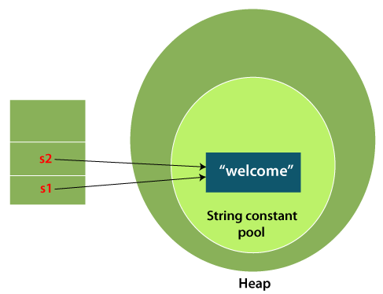

Slide 64
In the above example, only one object will be created.
Firstly, JVM will not find any string object with the value "Welcome" in string constant pool that is why it will create a new object.
After that it will find the string with the value "Welcome" in the pool, it will not create a new object but will return the reference to the same instance.
String objects are stored in a special memory area known as the "string constant pool".

Slide 65
Why Java uses the concept of String literal?
To make Java more memory efficient (because no new objects are created if it exists already in the string constant pool)

Slide 66
2) By new keyword
String s=new String("Welcome");//creates two objects and one reference variable
In such case, JVM will create a new string object in normal (non-pool) heap memory, and the literal "Welcome" will be placed in the string constant pool. The variable s will refer to the object in a heap (non-pool).
Java String Example
StringExample.java
public class StringExample{
public static void main(String args[]){
String s1="java";//creating string by Java string literal
char ch[]={'s','t','r','i','n','g','s'};
String s2=new String(ch);//converting char array to string
String s3=new String("example");//creating Java string by new keyword
System.out.println(s1);
System.out.println(s2);
System.out.println(s3);
}}

Slide 67
class StringStorage {
public static void main(String args[])
{
String s1 = "TAT";
String s2 = "TAT";
String s3 = new String("TAT");
String s4 = new String("TAT");
System.out.println(s1);
System.out.println(s2);
System.out.println(s3);
System.out.println(s4);
}
}

Slide 68
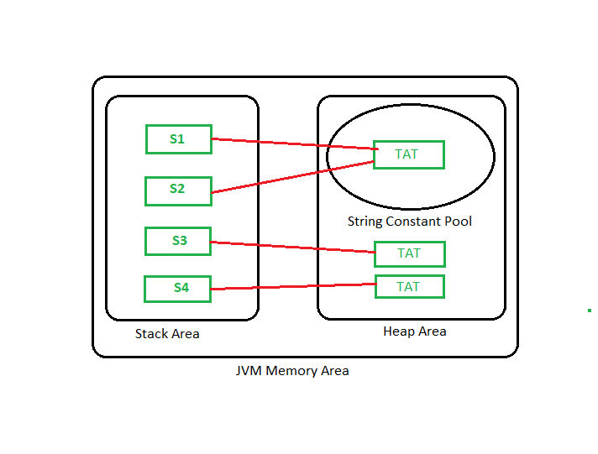

Slide 69
Immutable String in Java
In java, string objects are immutable. Immutable simply means unmodifiable or unchangeable.
Once a string object is created its data or state can’t be changed but a new string object is created.
class ABC {
public static void main(String[] args)
{
String s = "Sachin";
// concat() method appends
// the string at the end
s.concat(" Tendulkar");
// This will print Sachin
// because strings are
// immutable objects
System.out.println(s);
}
}

Slide 70
Here Sachin is not changed but a new object is created with “Sachin Tendulkar”. That is why a string is known as immutable.
As you can see in the given figure that two objects are created but s reference variable still refers to “Sachin” and not to “Sachin Tendulkar”.
But if we explicitly assign it to the reference variable, it will refer to the “Sachin Tendulkar” object.

Slide 71
Why string objects are immutable in java?
Because java uses the concept of string literal. Suppose there are 5 reference variables, all refers to one object “sachin”. If one reference variable changes the value of the object, it will be affected to all the reference variables. That is why string objects are immutable in java.

Slide 72
String Methods
The length method returns the number of characters in the string:
stringSize = name.length();
Here, the variable stringSize is assigned the number of characters in the string referenced by name.
The name.length() portion is called a method call.
To call a method is to execute it.
The length method is said to return the number of characters as an int.
A method returns a value if it sends a value back to where it was called.
There are many methods in the String class. A few include:
charAt(index);
toLowerCase();
toUpperCase();
Notes:
‹#›

Slide 73
String Methods Examples
length() – returns the number of characters in the string as an int
charAt(index) – index is an int value that specifies a character position in the string that is to be returned. The first character is at index 0. Return type is char.
toLowerCase() – returns a new string that is the lowercase equivalent of the string.
toUpperCase() – returns a new string that is the uppercase equivalent of the string.
Notes:
‹#›

Slide 74
StringBuffer class in Java
StringBuffer is a class in Java that represents a mutable sequence of characters. It provides an alternative to the immutable String class, allowing you to modify the contents of a string without creating a new object every time.

Slide 75
Here are some important features and methods of the StringBuffer class:
StringBuffer objects are mutable, meaning that you can change the contents of the buffer without creating a new object.
The append() method is used to add characters, strings, or other objects to the end of the buffer.
The insert() method is used to insert characters, strings, or other objects at a specified position in the buffer.
The delete() method is used to remove characters from the buffer.
The reverse() method is used to reverse the order of the characters in the buffer

Slide 76
public class StringBufferExample {
public static void main(String[] args)
{
StringBuffer sb = new StringBuffer();
sb.append("Hello");
sb.append(" ");
sb.append("world");
String message = sb.toString();
System.out.println(message);
}
}

Slide 77
There are several advantages of using StringBuffer over regular String objects in Java:
Mutable: StringBuffer objects are mutable, which means that you can modify the contents of the object after it has been created. In contrast, String objects are immutable, which means that you cannot change the contents of a String once it has been created.
Efficient: Because StringBuffer objects are mutable, they are more efficient than creating new String objects each time you need to modify a string. This is especially true if you need to modify a string multiple times, as each modification to a String object creates a new object and discards the old one.
Thread-safe: StringBuffer objects are thread-safe, which means multiple threads cannot access it simultaneously. In contrast, String objects are not thread-safe, which means that you need to use synchronization if you want to access a String object from multiple threads.
Overall, if you need to perform multiple modifications to a string, or if you need to access a string from multiple threads, using StringBuffer can be more efficient and safer than using regular String objects.

Slide 78
StringBuilder Class in Java
StringBuilder in Java represents a mutable sequence of characters. Since the String Class in Java creates an immutable sequence of characters, the StringBuilder class provides an alternative to String Class, as it creates a mutable sequence of characters.
The function of StringBuilder is very much similar to the StringBuffer class, as both of them provide an alternative to String Class by making a mutable sequence of characters.
However, the StringBuilder class differs from the StringBuffer class on the basis of synchronization. The StringBuilder class provides no guarantee of synchronization whereas the StringBuffer class does.

Slide 79
public static void main(String[] argv) throws Exception
{
// Create a StringBuilder object
// using StringBuilder() constructor
StringBuilder str = new StringBuilder();
str.append("ABC");
// print string
System.out.println("String = " + str.toString());
// create a StringBuilder object
// using StringBuilder(CharSequence) constructor
StringBuilder str1
= new StringBuilder("AAAABBBCCCC");
// print string
System.out.println("String1 = " + str1.toString());
// create a StringBuilder object
// using StringBuilder(capacity) constructor
StringBuilder str2 = new StringBuilder(10);
// print string
System.out.println("String2 capacity = "
+ str2.capacity());
// create a StringBuilder object
// using StringBuilder(String) constructor
StringBuilder str3
= new StringBuilder(str1.toString());
// print string
System.out.println("String3 = " + str3.toString());
}

Slide 80
What is the o/p ?
public static void main(String[] args)
{
StringBuffer s1=new StringBuffer("Buggy");
test(s1);
System.out.println(s1);
}
private static void test(StringBuffer s){
s.append("Bread");
}

Slide 81
What is the output?
public static void main(String[] args)
{
String s1=new String("Buggy");
test(s1);
System.out.println(s1);
}
private static void test(StringBuffer s){
s.append("Bread");
}

Slide 82
How many objects will be created for the following code?
String str1 = "Ashay";
String str2 = new String("Ashay");

Slide 83
Two objects. The first line creates one string object in the string pool. The second line will create one string object in heap memory and one in string pool but in the string pool, an object with the value “Ashay” is already present so the second line will not create an object in the string pool. So total objects created are two.

Slide 84
What is the output?
String str1 = "ABC";
str1 = str1 + "PQR";

Slide 85
How many objects will be created for the following code?
String str1 = "abc"
String str2 = "abc"

Slide 86
Only one object is created. String str1 will create a new object in String constant pool, while String str2 will create a reference to the String str1.

Slide 87
How many objects will be created for the following code:
String str1 = new String("abc");
String str2 = new String("abc");

Slide 88
Three objects are created. For the first statement(str1) two objects are created one in String constant pool and one in heap memory.
But for the second statement(str2), compulsory 1 new object is created in heap memory but no new object is created in string constant pool as it is already present.
Hence , a total of 2+1 = 3 objects are created

Slide 89
How do you compare two Strings in Java?
Use equals() method to compare two Strings.Avoid using "==" operator. The main reason to use equals() method is that it always compare String values i.e content. == operator compares the reference in the memory. Check the difference between == and equals() method in java.
String str1 = "abc";
String str2 = new String("abc");
System.out.println(str1 == str2); //false
System.out.println(str1.equals(str2)); //true

Slide 90
Assignment questionProgramming question
Write a program to reverse a String in java without using reverse() method?
Abhishek
kehsihbA

Slide 91
Why String class is Final in Java?
The reason behind the String class being final is because no one can override the methods of the String class. So that it can provide the same features to the new String objects as well as to the old ones.

Slide 92
What is immutable class?
An object is immutable when its state doesn’t change after it has been initialized. For example, String is an immutable class and, once instantiated, the value of a String object never changes.

Slide 93
Because an immutable object can’t be updated, programs need to create a new object for every change of state. However, immutable objects also have the following benefits:
An immutable class is good for caching purposes because you don’t have to worry about the value changes.
An immutable class is inherently thread-safe, so you don’t have to worry about thread safety in multi-threaded environments.

Slide 94
Steps for creating an immutable class
To create an immutable class in Java, you need to follow these general principles:
Declare the class as final so it can’t be extended.
Make all of the fields private so that direct access is not allowed.
Don’t provide setter methods for variables.
Make all mutable fields final so that a field’s value can be assigned only once.
Initialize all fields using a constructor method performing deep copy.
Perform cloning of objects in the getter methods to return a copy rather than returning the actual object reference.

